Slide 1

Algebra 1
Unit 14, Lesson 2 Interpreting Joint and Marginal Frequencies Volume 2, pg. 311

Slide 2


Benchmarks
MA.912.DP.3.1
Construct a two-way frequency table summarizing bivariate categorical data. Interpret joint and marginal frequencies and determine possible associations in terms of a real-world context.
MA.912.DP.1.1
Given a set of data, select an appropriate method to represent the data, depending on whether it is numerical or categorical data and on whether it is univariate or bivariate.
MA.912.DP.1.2
Interpret data distributions represented in various ways. State whether the data is numerical or categorical, whether it is univariate or bivariate, and interpret the different components and quantities in the display.
volume 2, pg. 311

Slide 3
Integrated Mathematical Thinking and Reasoning Standards
MA.K12.MTR.1.1 Actively participate in effortful learning both individually and collectively.
MA.K12.MTR.2.1 Demonstrate understanding by representing problems in multiple ways.
MA.K12.MTR.3.1 Complete tasks with mathematical fluency.
MA.K12.MTR.4.1 Engage in discussions that reflect on the mathematical thinking of self and others.
MA.K12.MTR.5.1 Use patterns and structure to help understand and connect mathematical concepts.
MA.K12.MTR.6.1 Assess the reasonableness of solutions.
MA.K12.MTR.7.1 Apply mathematics to real-world contexts.
volume 2, pg. 311

Slide 4

Learning Targets
I can determine joint and marginal frequencies.
I can interpret joint and marginal frequencies in a real‑world context.
I can interpret a graphical display for bivariate categorical data.
volume 2, pg. 311

Slide 5

Warm-Up
volume 2, pg. 311

Slide 6
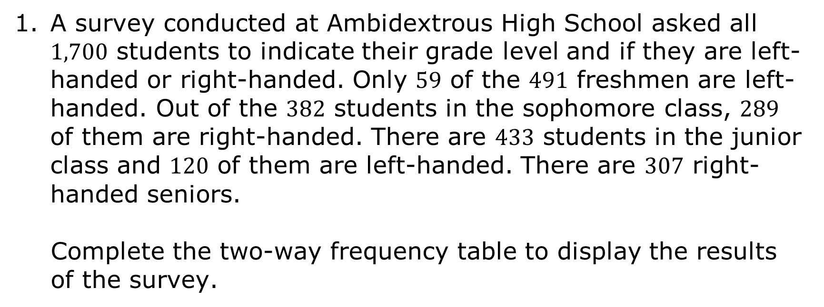
14.2.1 Warm-Up: Bell Work
A survey conducted at Ambidextrous High School asked all $1,700$ students to indicate their grade level and if they are left-handed or right-handed. Only $59$ of the $491$ freshmen are left-handed. Out of the $382$ students in the sophomore class, $289$ of them are right-handed. There are $433$ students in the junior class and $120$ of them are left‑handed. There are $307$ right-handed seniors.
Complete the two-way frequency table to display the results of the survey.
volume 2, pg. 311

Slide 7
Dominant Hand Survey
 |  |  |  |  | Total
Right-Handed
Left-Handed
Total
volume 2, pg. 311

Slide 8

Collaboration
volume 2, pg. 312

Slide 9

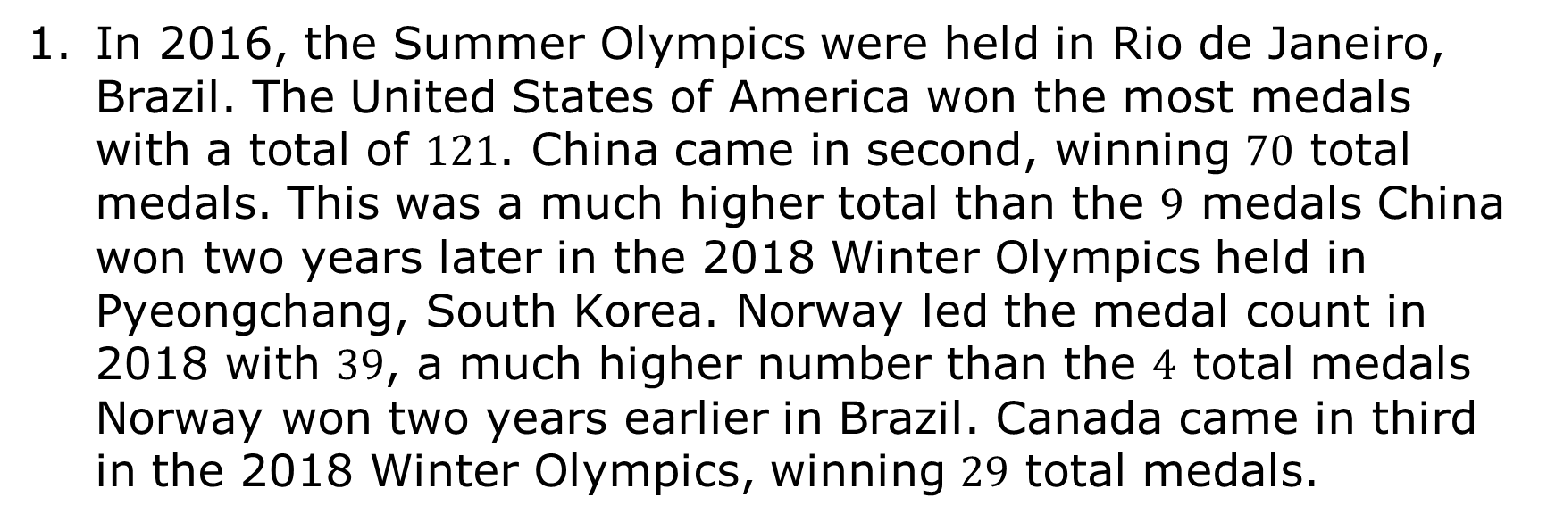
14.2.2 Collaboration: Joint and Marginal Frequencies
In 2016, the Summer Olympics were held in Rio de Janeiro, Brazil. The United States of America won the most medals with a total of $121$. China came in second, winning $70$ total medals. This was a much higher total than the $9$ medals China won two years later in the 2018 Winter Olympics held in Pyeongchang, South Korea. Norway led the medal count in 2018 with $39$, a much higher number than the $4$ total medals Norway won two years earlier in Brazil. Canada came in third in the 2018 Winter Olympics, winning $29$ total medals.
volume 2, pg. 312

Slide 10
Work with your partner to use the data regarding medal counts from the 2016 Summer Olympics and the 2018 Winter Olympics to make a two-way frequency table showing how the different countries’ medal counts compare to each other.
 | U.S. | China | Norway | Canada | Total
2016 Summer Olympics |  |  |  |  | 217
2018 Winter Olympics
Total | 144 |  |  |  | 317
How many total medals did the U.S. win in the 2016 and 2018 Olympics combined?
volume 2, pg. 312

Slide 11
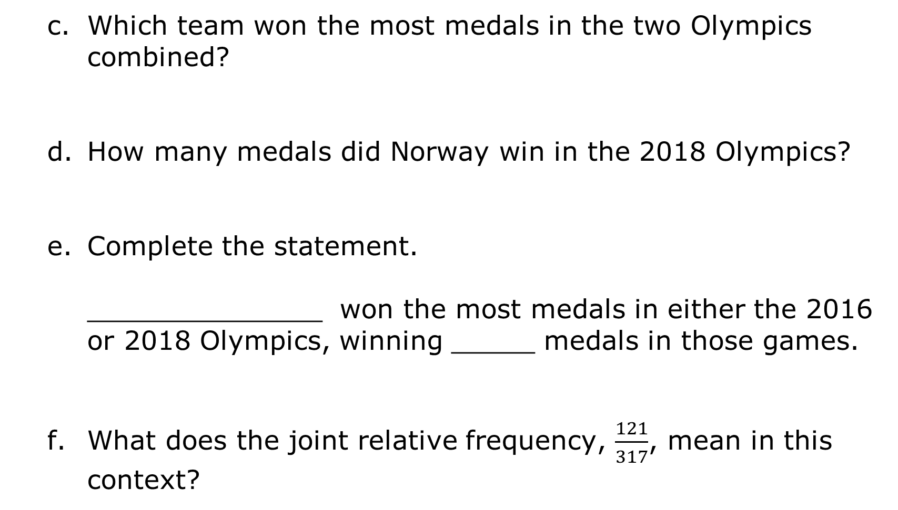
Which team won the most medals in the two Olympics combined?
How many medals did Norway win in the 2018 Olympics?
Complete the statement.
______________ won the most medals in either the 2016 or 2018 Olympics, winning _____ medals in those games.
What does the joint relative frequency, $\frac{121}{317}$, mean in this context?
volume 2, pg. 312

Slide 12
Work with your partner to write questions that can be answered with the data in the table.
Write at least one question that must be answered with a joint frequency.
Write at least one question that must be answered with a marginal frequency.
volume 2, pg. 313

Slide 13

Try It
volume 2, pg. 313

Slide 14

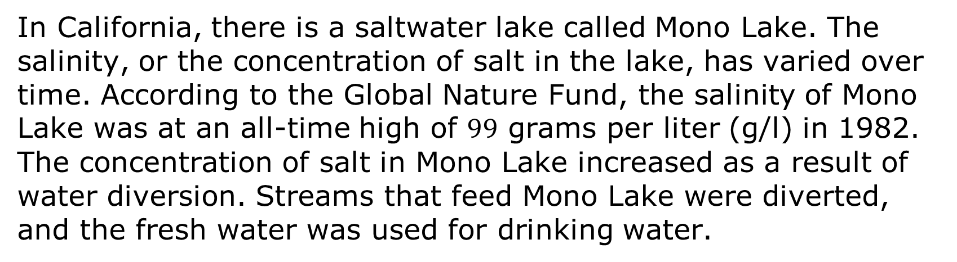
14.2.3 Try It: Mono Lake
In California, there is a saltwater lake called Mono Lake. The salinity, or the concentration of salt in the lake, has varied over time. According to the Global Nature Fund, the salinity of Mono Lake was at an all-time high of $99$ grams per liter (g/l) in 1982. The concentration of salt in Mono Lake increased as a result of water diversion. Streams that feed Mono Lake were diverted, and the fresh water was used for drinking water.
volume 2, pg. 313

Slide 15
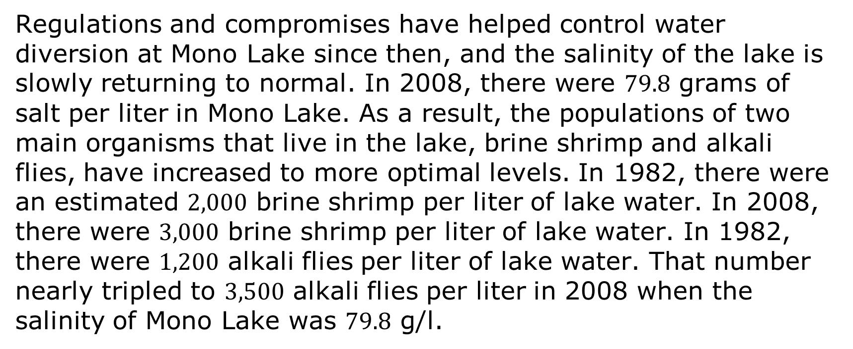
Regulations and compromises have helped control water diversion at Mono Lake since then, and the salinity of the lake is slowly returning to normal. In 2008, there were $79.8$ grams of salt per liter in Mono Lake. As a result, the populations of two main organisms that live in the lake, brine shrimp and alkali flies, have increased to more optimal levels. In 1982, there were an estimated $2,000$ brine shrimp per liter of lake water. In 2008, there were $3,000$ brine shrimp per liter of lake water. In 1982, there were $1,200$ alkali flies per liter of lake water. That number nearly tripled to $3,500$ alkali flies per liter in 2008 when the salinity of Mono Lake was $79.8$ g/l.
volume 2, pg. 313

Slide 16
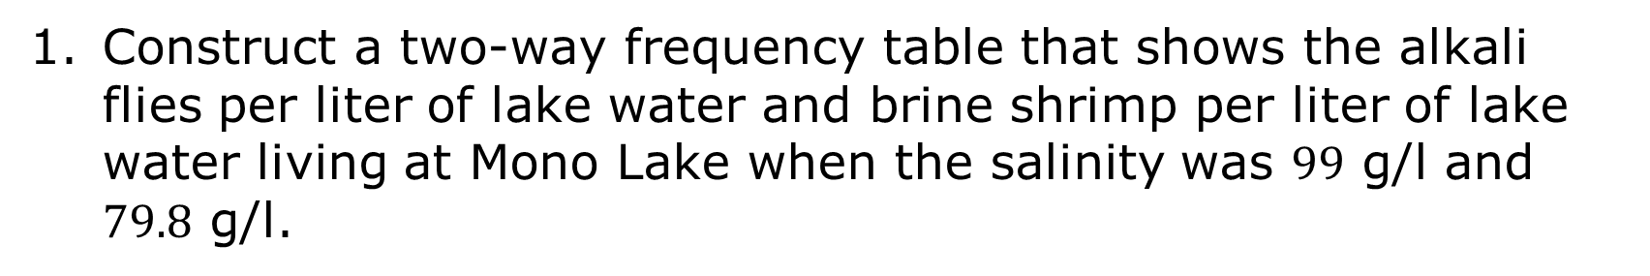
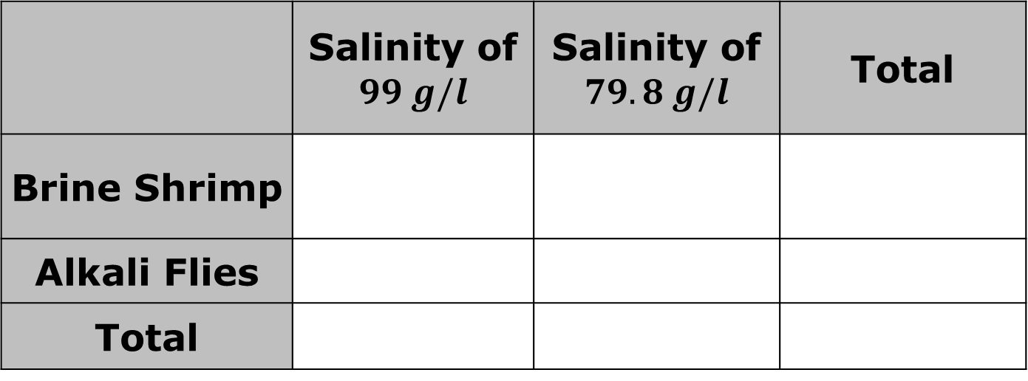
Construct a two-way frequency table that shows the alkali flies per liter of lake water and brine shrimp per liter of lake water living at Mono Lake when the salinity was $99$ g/l and $79.8$ g/l.
 | Salinity of $$99 g/l$$ | Salinity of $79.8 g/l$ | Total
Brine Shrimp
Alkali Flies
Total
volume 2, pg. 313

Slide 17
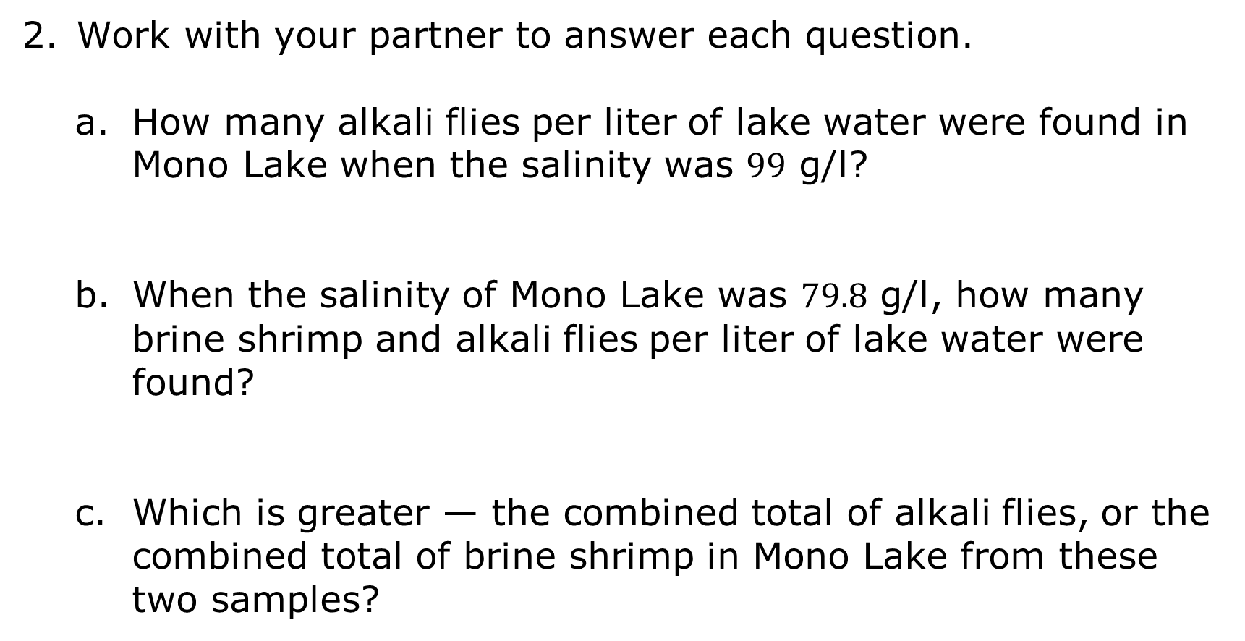
Work with your partner to answer each question.
How many alkali flies per liter of lake water were found in Mono Lake when the salinity was $99$ g/l?
When the salinity of Mono Lake was $79.8$ g/l, how many brine shrimp and alkali flies per liter of lake water were found?
Which is greater — the combined total of alkali flies, or the combined total of brine shrimp in Mono Lake from these two samples?
volume 2, pg. 314

Slide 18
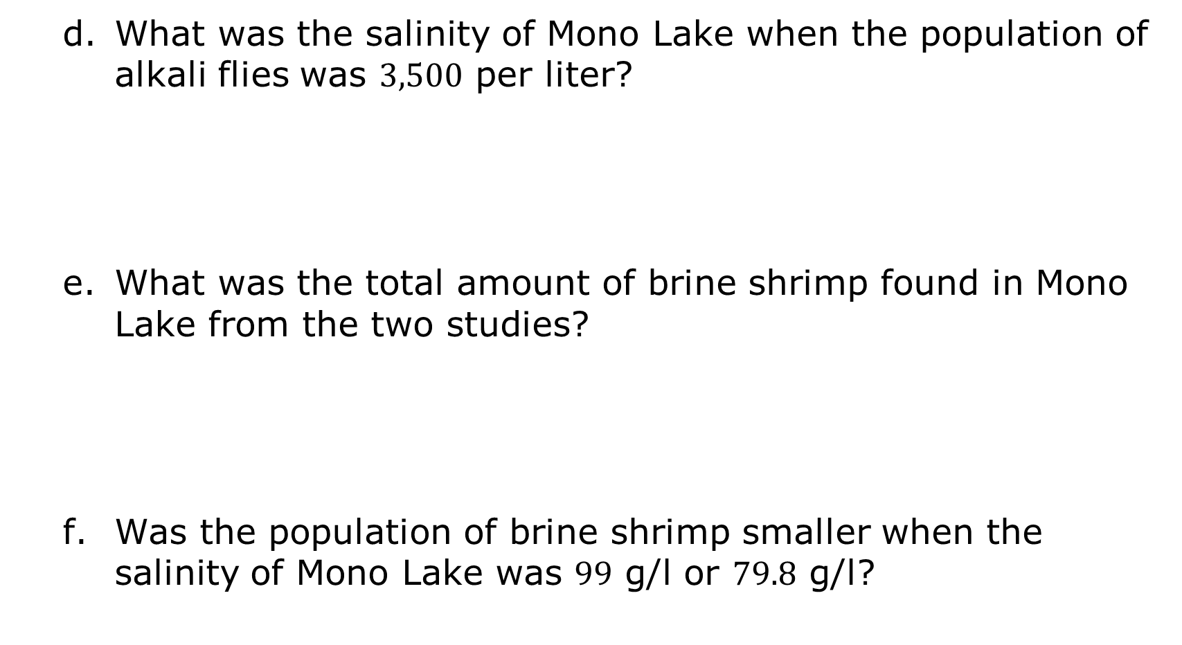
What was the salinity of Mono Lake when the population of alkali flies was $3,500$ per liter?
What was the total amount of brine shrimp found in Mono Lake from the two studies?
Was the population of brine shrimp smaller when the salinity of Mono Lake was $99$ g/l or $79.8$ g/l?
volume 2, pg. 314

Slide 19

Your Turn
volume 2, pg. 314

Slide 20
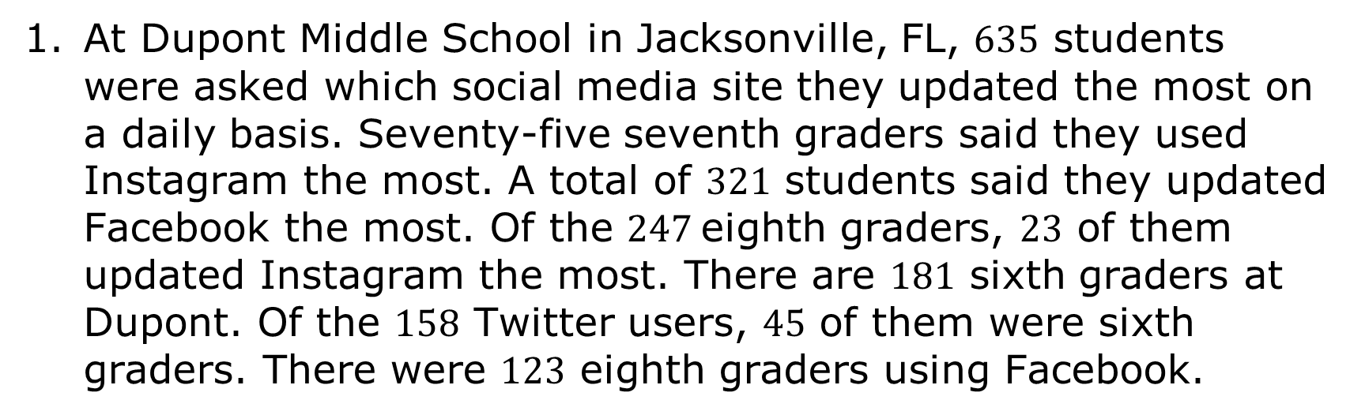
14.2.4 Your Turn!
At Dupont Middle School in Jacksonville, FL, $635$ students were asked which social media site they updated the most on a daily basis. Seventy-five seventh graders said they used Instagram the most. A total of $321$ students said they updated Facebook the most. Of the $247$eighth graders, $23$ of them updated Instagram the most. There are $181$ sixth graders at Dupont. Of the $158$ Twitter users, $45$ of them were sixth graders. There were $123$ eighth graders using Facebook.
volume 2, pg. 314

Slide 21
Complete the two-way table summarizing the data.
Dupont Middle School Social Media Preference
 | Facebook | Instagram | Twitter | Total
6th
7th
8th
Total
volume 2, pg. 314

Slide 22
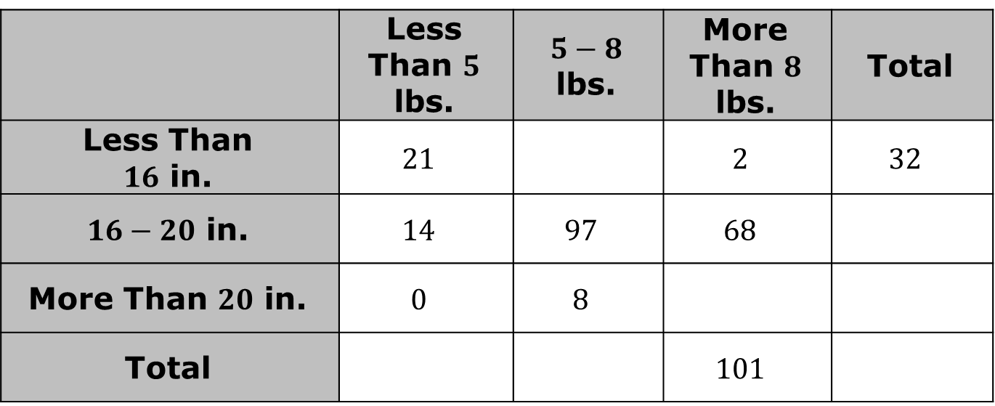
Austin studies birth weight and height as part of his research at Florida School of Traditional Midwifery in Gainesville, Florida. The following two-way table shows data from births in the month of June 2021 at UF Health Shands Hospital.
Births from UF Health Shands Hospital (June 2021)
 | Less Than $5$ lbs. | $5−8$ lbs. | More Than $8$ lbs. | Total
Less Than $16$ in. | $$21$$ |  | $$2$$ | $$32$$
$16−20$ in. | $$14$$ | $$97$$ | $$68$$
More Than $20$ in. | $$0$$ | $$8$$
Total |  |  | $$101$$
volume 2, pg. 315

Slide 23
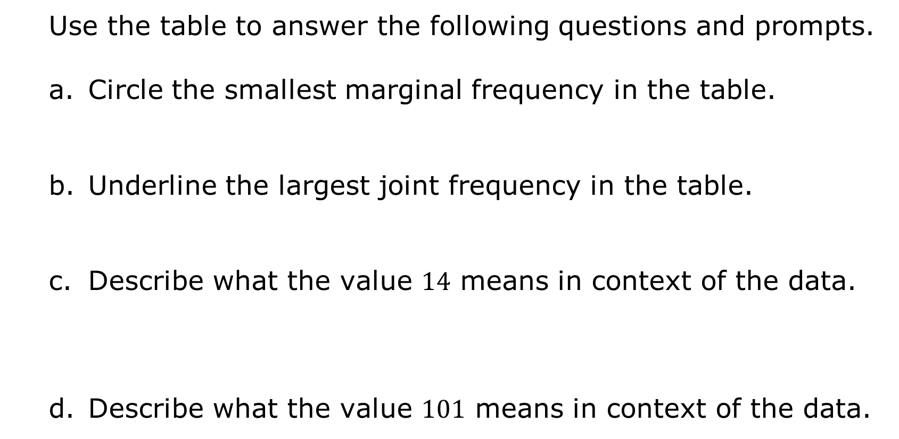
Use the table to answer the following questions and prompts.
Circle the smallest marginal frequency in the table.
Underline the largest joint frequency in the table.
Describe what the value $14$ means in context of the data.
Describe what the value $101$ means in context of the data.
volume 2, pg. 315

Slide 24

Wrap-Up
volume 2, pg. 315

Slide 25
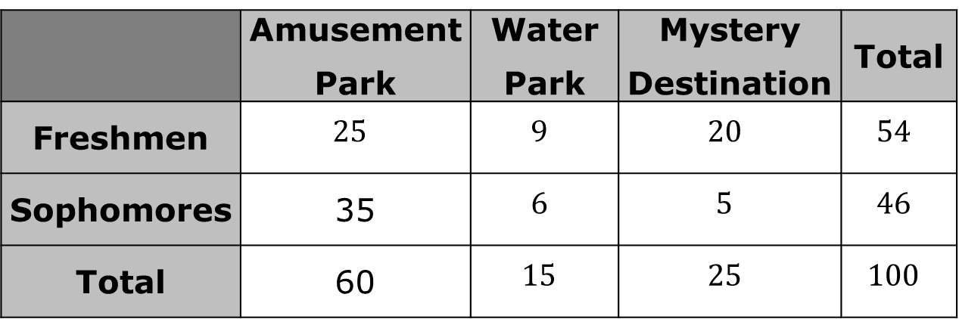
14.2.5 Wrap-Up: Ticket Out the Door
Use the two-way table showing students’ field trip preferences to answer the questions.
Underline the smallest joint frequency.
Explain what the smallest joint frequency represents in terms of students’ field trip preferences.
Students’ Field Trip Preferences
 | Amusement Park | Water Park | Mystery Destination | Total
Freshmen | $$25$$ | $$9$$ | $$20$$ | $$54$$
Sophomores | 35 | $$6$$ | $$5$$ | $$46$$
Total | 60 | $$15$$ | $$25$$ | $$100$$
volume 2, pg. 315

Slide 26
Circle the largest marginal frequency.
Explain what the largest marginal frequency represents in terms of students’ field trip preferences.
volume 2, pg. 315

